Slide 1
Global Sales Performance Dashboard
Internship Project Using Power BI

Slide 2
Project Overview
This project focuses on building an interactive Power BI dashboard using Kaggle’s global sales dataset (2011–2014). It compares regional sales, profits, and growth trends over time through map-based and line visualizations. The dashboard enables clear business insights and supports strategic decision-making through data storytelling.
Data Source : Kaggle (Global Sales Data, 2011-2014).
Tools Used : Python (data cleaning), Power BI (dashboard development).
Visuals Included : Map charts, line graphs , KPI Cards, Slicers , Donut chart, Treemap.
Insights Delivered : Compared regional sales performance and analyzed growth trends over time using interactive visualizations.
Business Value: Enables fast decisions, showcases top regions and products, and adapts easily to future datasets.

Slide 3
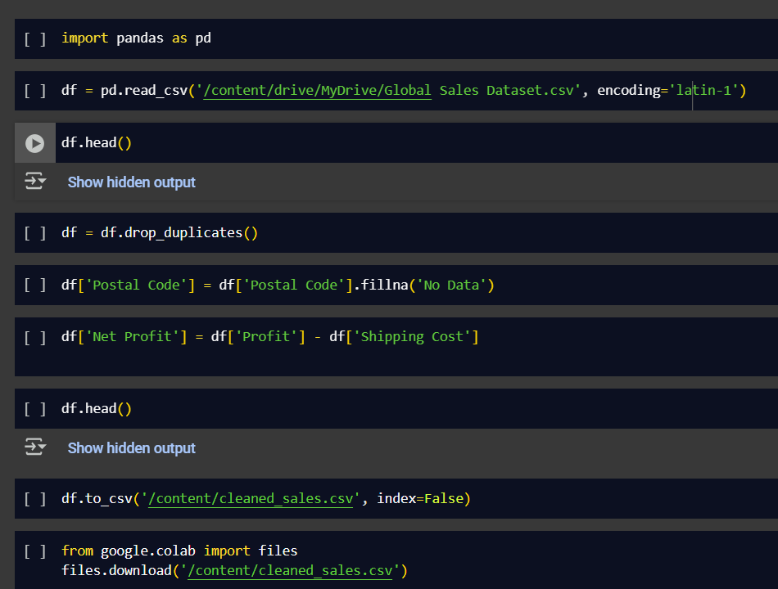
Data Cleaning & Preparation
Tools & Environment
Google Colab for Python scripting
Pandas for data manipulation
CSV file stored in Google Drive.
Key Cleaning Actions
Deduplication : Removed repeated entries to ensure data accuracy.
Missing Value Handling : Replaced nulls in Postal Code with “No Data”.
Feature Engineering : Created a new column “Net Profit” for deeper financial analysis.
Export : Saved and downloaded the cleaned dataset for Power BI integration.
Output
A clean, structured dataset with enhanced fields.
Ready for import into Power BI for dashboard.
Ensures compatibility and support business storytelling.

Slide 4
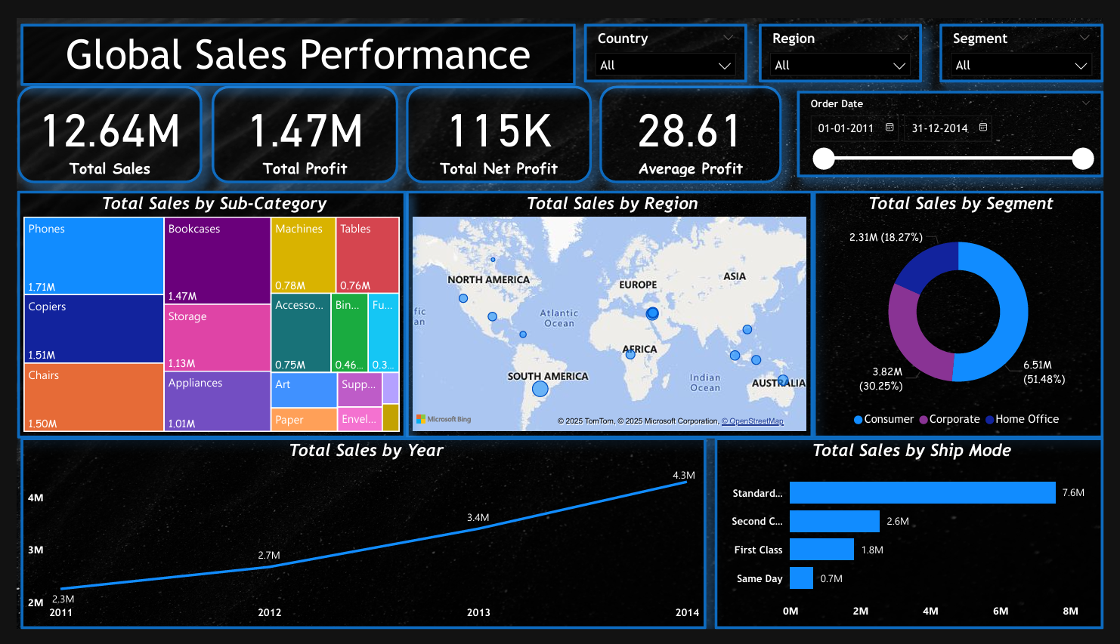
Dashboard Overview
Tool Used : Power BI for building interactive, multi page dashboards.

Slide 5
Dashboard Structure
Summary
Executive KPI Dashboard
Global Sales Dashboard
Insights & Interpretation
Insights & Interpretation 2
Project objective, key insights, and recommendations.
High-level metrics with slicers for quick filtering.
Detailed breakdown by region, segment, sub-category.
Strategic analysis of trends and customer behavior
Additional deep dives and supporting visuals

Slide 6
Sales Performance Insights
Central Region leads with ₹2.8M in total sales, showing consistent dominance.
Consumer Segment contributes 51.48% of overall sales, outperforming other segments.
Phones are the top sub-category across all years, indicating strong demand.
Standard Class shipping is preferred in over 60% of orders.
Sales grew from ₹2.3M to ₹4.3M — a 60% increase over the final year.
South and East Regions show lower sales, suggesting need for targeted strategies.

Slide 7
Business Recommendations
Boost South & East Region Sales : - Launch localized promotions and partner with regional distributors to improve reach and engagement.
Expand Phone Category Offerings : - Introduce bundled deals, accessories, and loyalty programs to capitalize on high demand.
Leverage Consumer Segment Growth : - Target repeat buyers with personalized email campaigns and excusive discounts.
Optimize Shipping Strategy : - Promote Standard Class shipping with incentives, while exploring faster options for premium customers.
Sustain Year-Over-Year Growth : - Invest in data-driven marketing and inventory planning to maintain upward sales trajectory.

Slide 8
Strategic Impact of Dashboard
Supports year-over-year growth trackin
This dashboard transforms raw sales data into actionable insights for strategic decision-making.
Enables quick comparison of regional sales performance.
Helps identify top-performing segments and products.
Supports year-over-year growth tracking.
Reveals high-potential regions for investment (e.g., Central).
Highlights underperforming areas needing attention (e.g., South, East).
Guides product strategy based on sub-category trends (e.g., Phones).
Dashboard built with clean, structured data.
Easily adaptable to new datasets, KPIs, or business domains.
Can be reused across departments or industries.
Executive-friendly layout with clear storytelling.

Slide 9
Conclusion
Cleaned, transformed, and visualized real-world sales data using Python and Power BI.
Built a multi-page, interactive dashboard with slicers, KPIs, and regional breakdowns.
Identified the Central region, Consumer segment, and Phones sub-category as top performers driving overall sales and profit-growth.
Suggested actions to improve sales, optimize shipping, and target underperforming areas.
Built a modular dashboard structure that can be easily adapted for new datasets, KPIs, or industries.
Delivered insights in a clear, executive-friendly format suitable for stakeholders.

Slide 10
Thanks for Reviewing My Internship Project
GitHub Repository : - https://github.com/AnuragPowtshyan/Global-Sales-Performance
Name: Anurag Kumar
Role:- Data Analyst Intern
University:- Indian Institute of Technology Patna
Internship at: Guvi HCL

